Slide 1
Leadership and Imagination
Matthew D Blythe

Slide 2
Seeing
And Seeing Again

Slide 3
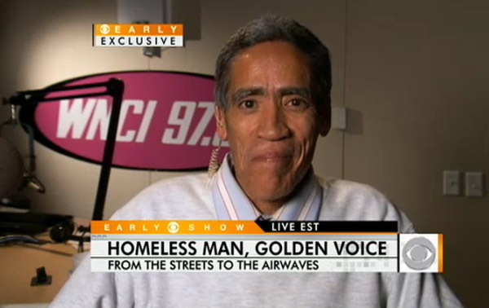
Seeing the Potential
Notes:
Seeing, and Seeing again mean looking past the filters that we have developed in our lives and seeing willing to look at something again with a different view. In the case of Ted Williams he became a YouTube sensation after a new photographer shot some video of him and it go on the air. Some one looked past the “Bum on the street” just long enough to hear his “Golden Voice”

Slide 4
Willingness to Invest
Seeing the beauty of what can be with some work.
Notes:
There are so many things in life that have great potential in we are only willing to invest the time and energy needed to make it great. Some times it a matter of using what you’re given and even that can be the wrong mindset. If we take something that doesn’t appear to be great because it’s all we can get, we’re missing out on seeing the beauty we can create and the new life we can give to something. Bringing new live to something that has otherwise been discarded as value-less can be one of the most meaningful things we can ever do.

Slide 5
Vision Casting
Notes:
Vision – health sciences, impact to the region… dare the dream big
When change is necessary… keeping the goal in mind and finding the new normal

Slide 6
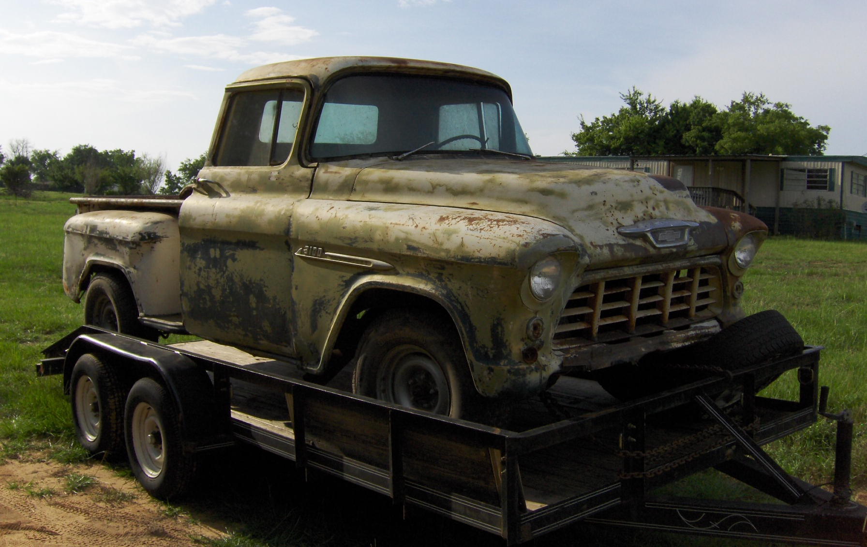
Seeing with Our Eyes Closed
Notes:
What if I told you that behind this green box was a beautiful white Chevrolet Pickup Truck built in 1955, what would you think? If I told you more about this truck, I’d tell you that it ran great, purred like a kitten and was the sweetest old rid to take a pretty girl out for a night on the town…. Now go and click on the green box and delete it… was I telling the truth? Some times it better not be able to see what we’re talking about at first. You could say that I got your hopes up, but I’d tell you that I was telling you the truth, it just needs a little work that’s all. Now click on that picture and click delete… Some times we need to let our imagination go a little so we can see the potential in things… we need to allow ourselves to dream so that we don’t let reality dampen our spirits. The first truck is beautiful, it just needs a little bit of work, but if we had preconceived expectations on this truck, we could have easily been turned off by the first picture and never could have enjoyed the new greatness of the last picture.

Slide 7
The Beauty of Nothing
Play the sound clip
Notes:
Wasn’t that sound wonderful!?!?! I’m reminded of the music and imagination class; Tony had given us musical instruments and told each group to present a song with what we were given. The first time around was pretty easy, we created a few beats and rolled out something creative, the second time he asked us to do it, it was a lot harder. With our time expired and nothing to show for it, my group decided to preform “silence.” Sometimes to hardest thing to do is nothing. We live in such a complex world that we end up having our lives be complex too. Maybe Simple is better, maybe we just need to stop and allow for some silence, in stead of looking at something and making a decision, maybe today we need to just stop, look again in silence and really see what it there when we’re allowed to sit it silence and what is really there, the ultimate “Seeing Again.”

Slide 8
Creative Understanding
Diversity, is it separation or unity with understanding?
Calling someone Friend… A letter from a co-worker…
Matthew You get credit for your professionalism and willingness to help me advance my work on behalf of the CON. I understand your political and religious views, and admire your ability to separate them from your work. You teach me tolerance and acceptance and I am better for knowing you. I love you for the God-centered man you are and am blessed to call you my friend. Elizabeth
Notes:
I never want to or be tolerated by people; I want to be in unity even if there are disagreements. This email from a co-worker of mine to me illustrates the need for creative understanding. This person has a preconceived notion that because we have different views on certain things that I wouldn’t be an advocate for her and help her. We need to learn to love like the Jesuits taught us to (thinking of the book Heroic Leadership). Its that love that allows for understanding and its that understanding that will being us all together if we only try.

